Slide 1
Operating System and
System Programming
Software College of SCU
四川大学软件学院 左航

Slide 2
Unit 11. Linking and Loading
11.1 Intro
11.2 Object File
11.3 Static Linking and loading
201001V1.1

Slide 3
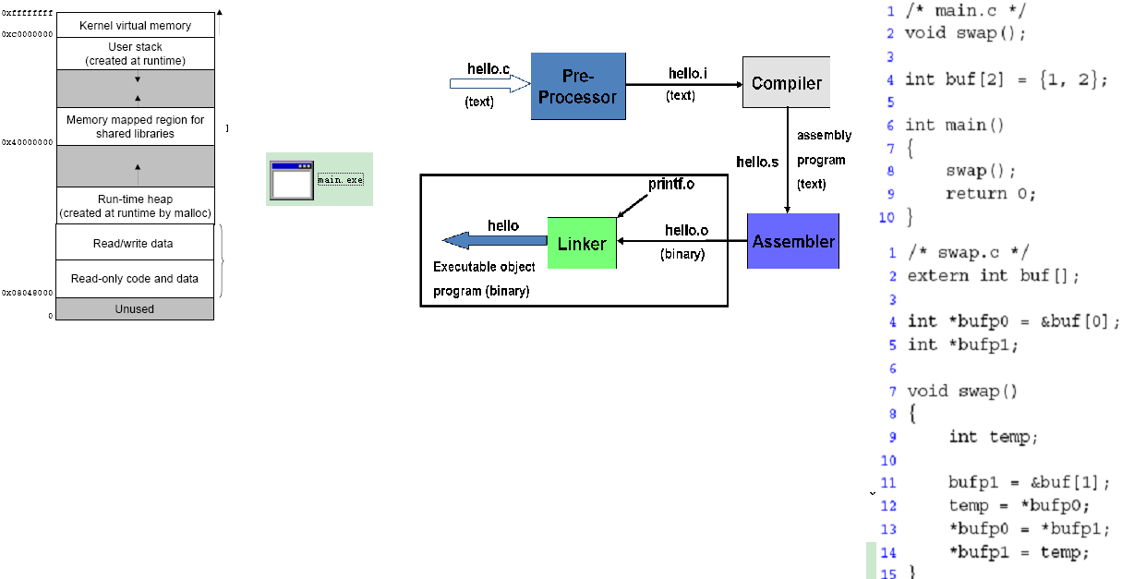
11.1 Intro(1/9)
loader
Linker
201001V1.1
Notes:
此处的linker loader 是为了便于分工讲述，不同系统不一定是分开的

Slide 4
11.1 Intro(2/9)
From source code to a process
  Most compilers produce relocatable object code 可重定位目标代码
    Addresses relative to zero
  The linker combines multiple object files and library modules into a single executable file
    Addresses also relative to zero
  The Loader reads the executable file
    Allocates memory
    Maps addresses within file to physical memory addresses
    Resolves names of dynamic library items （CSAPP 7.9)
Source
(.c, .cc)
Compiler
Object
(.obj)
Other Objects
(.obj)
Linker
Static libraries
(.lib)
Executable
Dynamic libraries
(.dll)
Loader
In-memory Image
201001V1.1
Notes:
Binding is the process of mapping names to addresses
Memory image: 内存映象

Slide 5
11.1 Intro(3/9)
Linking
  Linking is the process of collecting and combining the various pieces of code and data that a program needs in order to be loaded (copied) into memory and executed.
Linking can be performed:
  at compile time, when the source code is translated into machine code (static linking)
  at load time, when the program is loaded into memory (load-time dynamic linking)
  at run time, by application programs (run-time dynamic linking, GetProcAddress Windows API)
201001V1.1
Notes:
动态链接，在可执行文件装载时或运行时，由操作系统的装载程序加载库
静态链接使得不同的程序开发者和部门能够相对独立地开发和测试自己的程序模块，从某种意义上来讲大大促进了程序的开发效率，原先限制程序的规模也随之扩大。但是慢慢地静态链接的诸多缺点也逐步暴露出来，比如浪费内存和磁盘空间、模块更新困难等问题，使得人们不得不寻找一种更好的方式来组织程序的模块。
要解决空间浪费和更新困难这两个问题最简单的办法就是把程序的模块相互划分开来，形成独立的文件，而不再将他们静态的链接在一起。简单地讲，就是不对那些组成程序的目标文件进行链接，等到程序要运行时才进行链接。也就是说，把链接这个过程推迟到了运行时再进行，这就是动态链接(Dynamic Linking)的基本思想。

Slide 6
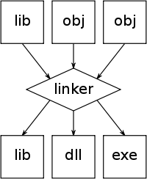
11.1 Intro(4/9)
Linker
  Linker or link editor is a program that takes one or more objects generated by a compiler and combines them into a single executable program
  ld, the linker included in Unix
201001V1.1
Notes:
Obj: Object files
Lib: static libraries

Slide 7
11.1 Intro(5/9)
Task of linker
  relocating relative addresses
  resolving external references
  But how? –twice pass
Problem:
1.Relocate code?
2.global/local variable address?
3.variable with same name?
Object File A
File Header
Output File
.text section
.data section
File Header
.bss section
.text
Object File B
.data
File Header
.text section
.bss
.data section
.bss section
201001V1.1

Slide 8
11.1 Intro(6/9)
Loading
  This process of copying the program into memory and then running it
Operating
System
1 GB
OxC0000000
User
Process
.text
.text
PE Header
3 GB
Ox08049000
MMU
Operating System
Page
Ox08048000
Ox00000000
Executable
Process Virtual
Space
Physical Memory
201001V1.1

Slide 9
11.1 Intro(7/9)
Loader
  A loader is a system program that performs the loading function (_execve：内核级系统调用执行一个文件 ).
  Some systems have a linker to perform the linking and a separate loader to handle relocation and loading.
  Some systems blurs the distinction between the compile-time process and the run-time process, many loaders also support relocation and linking.
201001V1.1
Notes:
典型的用法，就是在shell中，执行一个文件，比如说，一个编译好的文件，叫做helloworld，那么，在shell下执行./helloworld的时候，
shell就去fork()一个子进程，然后在子进程里面execve("./helloworld",NULL,NULL);
这样，就执行了这个文件！
具体点：
在shell中：
if(!fork())
{
execve("./helloworld",NULL,NULL);
exit(0);
}

Slide 10
11.1 Intro(8/9)
Why Study Linker and loader?
  Understanding linkers will help you build large programs.
  Understanding linkers will help you avoid dangerous programming errors.
  Understanding linking will help you understand how language scoping rules are implemented.
  Understanding linking will help you understand other important systems concepts.：比如：such as loading and running programs, virtual memory, paging, and memory mapping.
  Understanding linking will enable you to exploit shared libraries.
  To make the whole picture of CS
201001V1.1

Slide 11
11.1 Intro(9/9)
Platform
  IA32 + Linux + ELF + Gcc
  IA32 + Windows + PE/COFF + VC
201001V1.1

Slide 12
Unit 11.Linking and Loading
11.1 Intro
11.2 Object File
11.3 Static Linking and loading CSAPP7.1-7.9
201001V1.1

Slide 13
11.3 Static Linking and Loading
11.3.1 Static Linking
11.3.2 Symbol Table and Symbol Resolution
11.3.3 Relocation
11.3.4 Loading Executable Binaries
11.3.5 Creating your Static Libraries
201001V1.1

Slide 14
11.3.1 Static Linking (1/9)
Static linking is the result of the linker copying all library routines used in the program into the executable image.
  Executable image contains all object and library modules needed by program
  Entire image is loaded at once
Every loaded program contain duplicate copy of library routines.
  If calling “printf” 3 times ,then 3 copies exists.
This may require more disk space and memory than dynamic linking, but is both faster and more portable, since it does not require the presence of the library on the system where it is run.
201001V1.1

Slide 15
11.3.1 Static Linking (2/9)
Static library
  A package of related object modules, which can be supplied as input to the linker at compile time
    The linker copies only the object modules in the library that are actually referenced by the program
  Examples
    libc.a : standard C library that includes printf, scanf, strcpy, etc.
201001V1.1

Slide 16
11.3.1 Static Linking (3/9)
Source files
main2.c
vector.h
Translators
(cpp, cc1, as)
libvector.a
libc.a
Static libraries
Relocatable
object files
main2.o
addvec.o
printf.o and any other
modules called by printf.o
Linker (ld)
Fully linked
executable object file
p2
201001V1.1

Slide 17
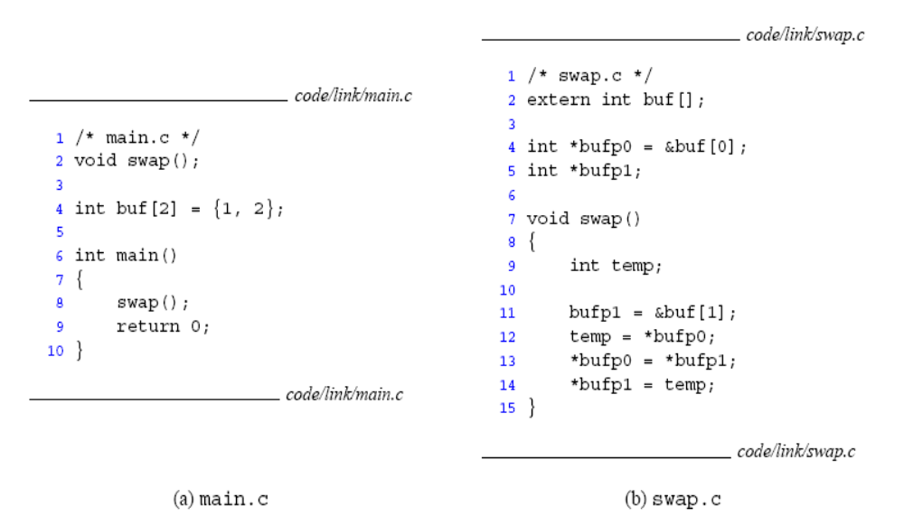
11.2.1 Static Linking (4/9)
201001V1.1

Slide 18
11.2.1 Static Linking (5/9)
Global/local/external
Variable Or function
main.c
swap.c
Translators
Translators
Separately compiled relocatable object files
main.o
swap.o
Linker
Executable object file (contains code and data for all functions defined in m.c and a.c)
p
201001V1.1

Slide 19
11.2.1 Static Linking (6/9)
Object File A
File Header
File Header
.text section
.data section
.text
Object File B
.bss section
File Header
.text section
.data section
.data
Object File C
.bss section
File Header
.text section
.data section
.bss
.bss section
实际的空间分配策略
201001V1.1

Slide 20
11.2.1 Static Linking(7/9)
Problem to solve:
  1.Relocate code: address change?
  2.global/local variable/function address change?
  3.variable with same name: linker policy?
Answer: linker work two-pass
201001V1.1

Slide 21
11.2.1 Static Linking (8/9)
Static linker performs two main tasks to build executable object file.
  PASS 1.Symbol Resolution/符号解析： Object files define and reference symbols.
    The purpose of symbol resolution is to associate each symbol reference with exactly one symbol definition
  PASS 2.Relocation/重定位： Compilers and assemblers generate code and data sections that start at address zero.
    The linker relocates these sections by associating a memory location with each symbol definition, and then modifying all of the references to those symbols so that they point to this memory location.
201001V1.1
Notes:
IN each pass, follow the order of ONE Section after another

Slide 22
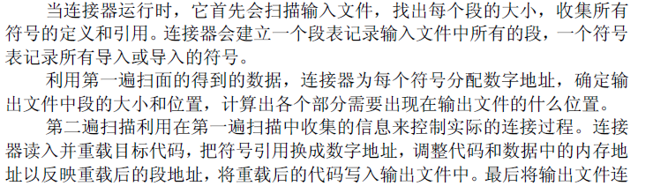
Ref: linker and loader.pdf
201001V1.1

Slide 23
11.3 Static Linking and Loading
11.3.1 Static Linking
11.3.2 Symbol Table and Sysmbol Resolution符号表和符号解析
11.3.3 Relocation
11.3.4 Loading Executable Binaries
11.3.5 Creating your Static Libraries
201001V1.1

Slide 24
11.3.2 Symbol Table and Symbol Resolution(1/9)
Three kinds of linker symbols 7.5
  Global symbols that are defined by module m and that can be referenced by other modules.
    Nonstatic C functions and nonstatic global variabless
  Global symbols that are referenced by module m, but defined by other module
    These are called externals.
  Local symbols that are defined and referenced exclusively by module m
    Static C functions and static variables
    Local procedure variables that are defined with C static attribute are not managed on the stack. Instead, the compiler allocates space in .data or in .bss
    Local linker symbol ≠ local program variable (not managed by Compiler)
201001V1.1

Slide 25
11.3.2 Symbol Table and Symbol Resolution(2/9)
Symbol Table (gene by assembler? ) Definition same as slider 82
typedef struct _IMAGE_SYMBOL {
union {
BYTE ShortName[8];
struct {
DWORD Short; // if 0, use LongName
DWORD Long; // offset into string table
} Name;
DWORD LongName[2]; // PBYTE [2]
} N;
DWORD Value;
SHORT SectionNumber;//节编号
WORD Type;//文件、函数、变量...
BYTE StorageClass;
BYTE NumberOfAuxSymbols;//辅助表项
} IMAGE_SYMBOL;
typedef IMAGE_SYMBOL UNALIGNED *PIMAGE_SYMBOL;
#define IMAGE_SIZEOF_SYMBOL 18
201001V1.1

Slide 26
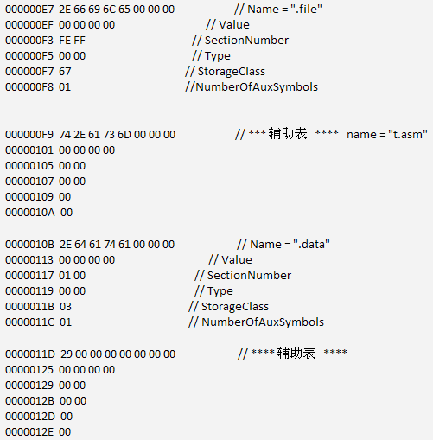
11.3.2 Symbol Table and Symbol Resolution(3/9)
Example Symbol table
201001V1.1

Slide 27
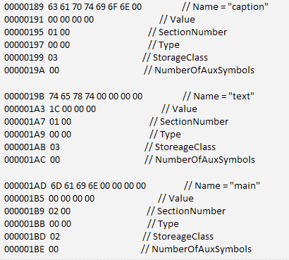
11.3.2 Symbol Table and Symbol Resolution(4/9)
Example Symbol table
201001V1.1
Notes:
External: 2
Static: 3

Slide 28
UNIX---main.o
Num: Value size type bind ot Ndx name
8: 0 8 OBJECT GLB 0 3(.data) buf
9: 0 17 FUNC GLB 0 1(.text) main
10: 0 0 notype GLB 0 und swap
201001V1.1

Slide 29
11.3.2 Symbol Table and Symbol Resolution(5/9)
Symbol resolution 符号解析
  The linker associates each reference with exactly one symbol definition
  References to local symbols defined in the same module is straightforward
  Resolving references to global variables is trickier
    The same symbol might be defined by multiple object files
201001V1.1

Slide 30
11.3.2 Symbol Table and Symbol Resolution(6/9)
void foo(void);
int main() {
foo();
return 0;
}
Symbol resolution
--------------------Configuration: 1 - Win32 Debug--------------------
Compiling...
main.c
main.obj - 0 error(s), 0 warning(s)
Linking...
main.obj : error LNK2001: unresolved external symbol _foo
Debug/1.exe : fatal error LNK1120: 1 unresolved externals
Error executing link.exe.
1.exe - 2 error(s), 0 warning(s)
201001V1.1

Slide 31
11.3.2 Symbol Table and Symbol Resolution(7/9)
Program symbols are either strong or weak
  Strong强符号: procedures and initialized globals
  weak: uninitialized globals
    At compile time, the compiler exports each global symbol to the assembler as either strong or weak, and the assembler encodes this information implicitly in the symbol table of the relocatable object file
p1.c
p2.c
strong
int foo=5;
p1() {
}
int foo;
p2() {
}
weak
strong
strong
201001V1.1

Slide 32
11.3.2 Symbol Table and Symbol Resolution(8/9)
Linker’s Symbol Resolution Rules
    Rule 1. A strong symbol can only appear once, otherwise compile error.
    Rule 2. A weak symbol can be overridden by a strong symbol of the same name.
    references to the weak symbol resolve to the strong symbol.
    Rule 3. If there are multiple weak symbols, the linker can pick an arbitrary one.
在新版的不同编译系统中，对改规则反映不一：
1.VS 中同名变量互相独立，无论强弱皆不会出现问题；
2.TMD-GCC下，同名不论强弱皆无法通过编译
201001V1.1

Slide 33
11.3.2 Symbol Table and Symbol Resolution(9/9)
Linker Puzzles： error in addr ,not in datatype
int x;
p1() {}
p1() {}
Link time error: two strong symbols (p1)
int x;
p1() {}
int x;
p2() {}
References to x will refer to the same
uninitialized int. Is this what you really want?
int x;
int y;
p1() {}
double x;
p2() {}
Writes to x in p2 might overwrite y!
Evil!
int x=7;
int y=5;
p1() {}
double x;
p2() {}
Writes to x in p2 will overwrite y!
Nasty!
int x=7;
p1() {}
int x;
p2() {}
References to x will refer to the same initialized
variable.
201001V1.1

Slide 34
11.3 Static Linking and Loading
11.3.1 Static Linking
11.3.2 Symbol Table and Symbol Resolution
11.3.3 Relocation
11.3.4 Loading Executable Binaries
11.3.5 Creating your Static Libraries
201001V1.1

Slide 35
11.3.3 Relocation (1/15)
After the symbol resolution phase
  Once the symbol resolution step has been completed, the linker associates each symbol reference in the code with exactly one symbol definition
  That is relocation----pass 2.
201001V1.1

Slide 36
11.3.3 Relocation (2/15)
Relocation consists of 2 steps
  Relocating sections and symbol definitions
    Merges all sections of the same type into a new aggregate section
      .data sections from all the input modules are merged into a single .data section
    Assign run-time memory addresses to the new aggregate sections and to each symbol defined internally in each module
  Relocating symbol references within sections
    Modify external references so that they point to the correct run-time addresses
      To perform this step, the linker relies on relocation entries in the relocatable object modules
201001V1.1
Notes:
run-time memory addresses is not physical address

Slide 37
11.3.3 Relocation (3/15)
Object File A
File Header
File Header
.text section
.data section
.text
Object File B
.bss section
File Header
.text section
.data section
.data
Object File C
.bss section
File Header
.text section
.data section
.bss
.bss section
实际的空间分配策略
201001V1.1

Slide 38
11.3.3 Relocation (4/15)
m.c
a.c
int e=7;
int main() {
int r = a();
exit(0);
}
extern int e;
int *ep=&e;
int x=15;
int y;
int a() {
return *ep+x+y;
}
201001V1.1

Slide 39
11.3.3 Relocation (5/15)
Relocation Sections (Step 1)
Relocatable Object Files
Executable Object File
system code
.text
0
headers
system data
.data
system code
main()
.text
a()
main()
.text
m.o
more system code
int e = 7
.data
system data
int e = 7
.data
a()
.text
int *ep = &e
int x = 15
a.o
int *ep = &e
.data
uninitialized data
.bss
int x = 15
.symtab
.debug
int y
.bss
201001V1.1

Slide 40
11.3.3 Relocation (6/15)
Resolving External References (Step 2)
  Symbols are lexical词汇的 entities that name functions and variables.
  Each symbol has a value (typically a memory address).
  Code consists of symbol definitions and references.
  References can be either local or external.
201001V1.1

Slide 41
11.3.3 Relocation (7/15)
m.c
a.c
int e=7;
int main() {
int r = a();
exit(0);
}
extern int e;
int *ep=&e;
int x=15;
int y;
int a() {
return *ep+x+y;
}
Def of local
symbol e
Ref to
external
symbol e
Def of
local
symbol
ep
Defs of local
symbols x and y
Ref to external
symbol exit
(defined in
libc.so)
Ref to external
symbol a
Def of
local
symbol a
Refs of local
symbols ep,x,y
201001V1.1

Slide 42
11.3.3 Relocation (8/15)
Relocation entry
Example in next slider with red color;
  Typedef struct{
  int offset; // offset of ref to relocate
  int symbol:24,//int symbol the ref should point to
  type:8;//int relocation type
  }
R_386_PC32:relative addr ref
R_386_32: absolute addr ref
201001V1.1
Notes:
Obj 里类似

Slide 43
11.3.3 Relocation (9/15)
m.o Relocation Info
Disassembly of section .text:
00000000 <main>: 00000000 <main>:
0: 55 pushl %ebp
1: 89 e5 movl %esp,%ebp
3: e8 fc ff ff ff call 4 <main+0x4>
4: R_386_PC32 a
8: 6a 00 pushl $0x0
a: e8 fc ff ff ff call b <main+0xb>
b: R_386_PC32 exit
f: 90 nop
m.c
int e=7;
int main() {
int r = a();
exit(0);
}
Disassembly of section .data:
00000000 <e>:
0: 07 00 00 00
Relocation entry
relative addr
201001V1.1
Notes:
8: 6a 00 ,8表示这是main的代码段中第8个字节
4: R_386_PC32 a， 4表示需要定位的地址是第4个字节，第3个字节是CALL

Slide 44
11.3.3 Relocation (10/15)
a.o Relocation Info (.text)
Disassembly of section .text:
00000000 <a>:
0: 55 pushl %ebp
1: 8b 15 00 00 00 movl 0x0,%edx
6: 00
3: R_386_32 ep
7: a1 00 00 00 00 movl 0x0,%eax
8: R_386_32 x
c: 89 e5 movl %esp,%ebp
e: 03 02 addl (%edx),%eax
10: 89 ec movl %ebp,%esp
12: 03 05 00 00 00 addl 0x0,%eax
17: 00
14: R_386_32 y
18: 5d popl %ebp
19: c3 ret
a.c
extern int e;
int *ep=&e;
int x=15;
int y;
int a() {
return *ep+x+y;
}
201001V1.1
Notes:
3,8,14 分别是指要替换的地址在a的.text段中的编码地址。
比如：3指偏移量3；8指从7位a1(movl),8为需要替换的地址
a（）函数外的全局变量的初始化指令并不在代码段中，在链接加载可执行代码时，该工作已经完成

Slide 45
11.3.3 Relocation (11/15)
a.o Relocation Info (.data)
a.c
extern int e;
int *ep=&e;
int x=15;
int y;//.bss
int a() {
return *ep+x+y;
}
Disassembly of section .data:
00000000 <ep>:
0: 00 00 00 00
0: R_386_32 e
00000004 <x>:
4: 0f 00 00 00
201001V1.1
Notes:
Y在bss段故不在.data中

Slide 46
11.3.3 Relocation (12/15)
Executable After Relocation (.text)
08048530 <main>:
8048530: 55 pushl %ebp
8048531: 89 e5 movl %esp,%ebp
8048533: e8 08 00 00 00 call 8048540 <a>
8048538: 6a 00 pushl $0x0
804853a: e8 35 ff ff ff call 8048474 <_init+0x94>
804853f: 90 nop
08048540 <a>:
8048540: 55 pushl %ebp
8048541: 8b 15 1c a0 04 movl 0x804a01c,%edx
8048546: 08
8048547: a1 20 a0 04 08 movl 0x804a020,%eax
804854c: 89 e5 movl %esp,%ebp
804854e: 03 02 addl (%edx),%eax
8048550: 89 ec movl %ebp,%esp
8048552: 03 05 d0 a3 04 addl 0x804a3d0,%eax
8048557: 08
8048558: 5d popl %ebp
8048559: c3 ret
ep
x
y
201001V1.1
Notes:
8048533: e8 08 00 00 00 call 8048540 <a>
此时pc 指向下一条指令即8048538，pc+8 即8048540
Exit的代码应当在进程虚拟地址空间的共享库映射区域，其地址小于代码段

Slide 47
11.3.3 Relocation (13/15)
Executable After Relocation (.data)
int e=7;
int main() {
int r = a();
exit(0);
}
m.c
Disassembly of section .data:
0804a018 <e>:
804a018: 07 00 00 00
0804a01c <ep>:
804a01c: 18 a0 04 08
0804a020 <x>:
804a020: 0f 00 00 00
extern int e;
int *ep=&e;
int x=15;
int y;
int a() {
return *ep+x+y;
}
a.c
Address value
201001V1.1

Slide 48
11.3.3 Relocation (14/15)
For each section s{
for each location entry r{
relocation processs
}
}
201001V1.1

Slide 49



11.3.3 Relocation (15/15)
201001V1.1

Slide 50
11.3 Static Linking and Loading
11.3.1 Static Linking
11.3.2 Symbol Table and Symbol Resolution
11.3.3 Relocation
11.3.4 Loading Executable Binaries 7.8
11.3.5 Creating your Static Libraries
201001V1.1

Slide 51
11.3.4 Loading Executable Binaries (1/5)
Executable object file for
example program p
Process image (see next page)
0
PE header
Program header table
(required for executables)
init and shared lib
segments
.text section
.data section
.bss section
.text segment
(r/o)
.symtab
.rel.text
.data segment
(initialized r/w)
.rel.data
.debug
Section header table
(required for relocate tables)
.bss segment
(uninitialized r/w)
201001V1.1
Notes:
Section7.4
.rel.text rel.data 对于重定位好的可执行文件,此2节可以没有
其作用是给出text或data中需要重定位的符号（变量或函数）
在箭头所指的段头部表的指引下加载器拷贝文件到进程（存储器）映像

Slide 52
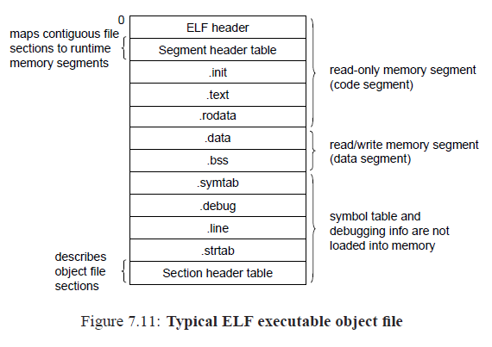
11.3.4 Loading Executable Binaries (2/5)
201001V1.1

Slide 53
11.3.4 Loading Executable Binaries (3/5)
Memory
invisible to
user code
Kernel virtual memory
0xc0000000
User stack
(created at runtime)
%esp (stack pointer)
Memory-mapped region for
shared libraries
Linux Run-time
Memory Image
0x40000000
brk
Run-time heap
(created by malloc)
Read/write segment
(.data, .bss)
Loaded from the
executable file
Read-only segment
(.init, .text, .rodata)
0x08048000
201001V1.1
0
Unused

Slide 54
11.3.4 Loading Executable Binaries (4/5)
Startup Routines for C program
  When the loader (execve) runs
    It creates the memory image by copying chunks of the executable object files into the code and data segments (guided by the segment header table)
  The loader jumps to the program’s entry point,
    Which is the address of the _start symbol.
201001V1.1
Notes:
在箭头所指的段头部表的指引下加载器拷贝文件到进程（存储器）映像

Slide 55
11.3.4 Loading Executable Binaries (5/5)
The startup code at the _start address is defined in the object file crt1.o
  0x080480c0 <_start>: /* entry point in .text */
    call __libc_init_first /* startup code in .text */
    call _init /* startup code in .init */
    call atexit /* startup code in .text ,注册调用exit的例程*/
    call main /* application code */
    call _exit /* return control to OS */
201001V1.1
Notes:
请阅读7.9节相关说明

Slide 56
11.3 Static Linking and Loading
11.3.1 Static Linking
11.3.2 Symbol Table and Symbol Resolution
11.3.3 Relocation
11.3.4 Loading Executable Binaries
11.3.5 Creating your Static Libraries
201001V1.1

Slide 57
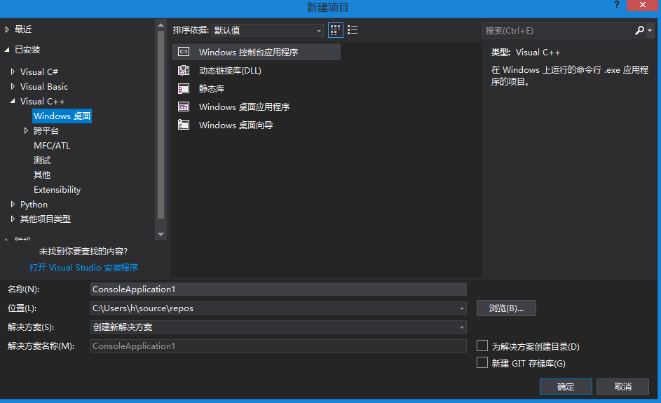
11.3.5 Creating your Static Libraries(1/1)
Example of Creating and Using Static Libraries
201001V1.1

Slide 58
Summary
Linker – key part of OS – not in kernel
  Combines object files and libraries into a “standard” format that the OS loader can interpret
  Resolves references and does static relocation of addresses
  Creates information for loader to complete binding process
  Supports dynamic shared libraries
201001V1.1

Slide 59
Unit 11.Linking and Loading
11.1 Intro
11.2 Object File :
11.3 Static Linking and loading
201001V1.1

Slide 60
11.2 Object File
11.2.1 Object File Introduction
11.2.2 COFF
11.2.3 PE
201001V1.1

Slide 61
11.2.1 Object File Introduction (1/3)
Object files are binary representations of programs created by the assembler and linker
There are three main types of object files.
  Relocatable object file, .obj .lib(Windows), .o, .a(Linux)
  Executable object file, .exe(Windows), /bin,/sbin
  Shared object file, .dll(Windows), .so(Linux)
Relocatable
object files
Executable object file
Linker
201001V1.1
Notes:
P465
另外在软件的安装后文件夹中大部分软件或服务器软件都有个 bin 文件夹 bin 文件夹里面存放的一般是可执行的二进制文件

Slide 62
11.2.1 Object File Introduction (2/3)
Object File Format Standard
  UNIX/LINUX:
    a.out (assembler and link editor output)
    COFF (Common Object File Format)
    ELF (Executable and Linking Format)
  Windows Platform
    COFF (.obj file)
    Portable Executable, PE (.exe,.dll file)
201001V1.1
Notes:
在WIN下生成的EXE文件是PE格式的，但OBJ文件还是COFF格式的
ELF pe是COFF的变种

Slide 63
11.2.1 Object File Introduction (3/3)
Object file includes:
  Header and optional header
  Section Header Tables
  Sections
201001V1.1

Slide 64
11.2 Object File
11.2.1 Object File Introduction
11.2.2 COFF
11.2.3 PE
201001V1.1

Slide 65
11.2.2 COFF (1/19)
Common Object File Format：一般目标文件格式
  The COFF Object Format is used both for object files (.o, .obj extension) and executable files.
  Some of the information is only present in object files, other information is only present in the executable files.
  The main components of a COFF file are sections.
RVAs (Relative Virtual Address).
  An RVA is an address relative to the memory load address
  (Virtual address 0x10464)-(base address 0x10000) = RVA 0x00464
201001V1.1
Notes:
Win 下obj是coff,exe是PE

Slide 66
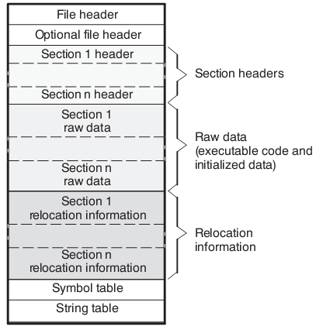
11.2.2 COFF (2/19)
COFF file Structure
201001V1.1

Slide 67
11.2.2 COFF (3/19)
COFF File Components Description
  File header
    Contains general information; always present.
  Optional header
    Contains information about an executable file; usually only present in executables.
  Section header
    Contains information about the different COFF sections; one for each section.
  Raw data sections
    One for each section containing raw data, such as machine instructions and initialized variables.
201001V1.1
Notes:
Grouped Sections (Object Only)
The “$” character (dollar sign) has a special interpretation in section names in object files.
When determining the image section that will contain the contents of an object section, the linker
discards the “$” and all characters following it. Thus, an object section named .text$X will actually contribute to the .text section in the image.
However, the characters following the “$” determine the ordering of the contributions to the image section. All contributions with the same object-section name will be allocated contiguously in the image, and the blocks of contributions will be sorted in lexical order by object-section name. Therefore, everything in object files with section name .text$X will end up together, after the .text$W contributions and before the .text$Y contributions.
The section name in an image file will never contain a “$” character.

Slide 68
11.2.2 COFF (4/19)
  Relocation information
    one for each section having external references. Usually only present in object files and not in executable files.
  Line number information
    Contains debugging information about source line numbers; one for each section if compiled with the -g option
  Symbol table
    Contains information about all the symbols in the object file
  String table
    Contains long symbol names.
201001V1.1

Slide 69
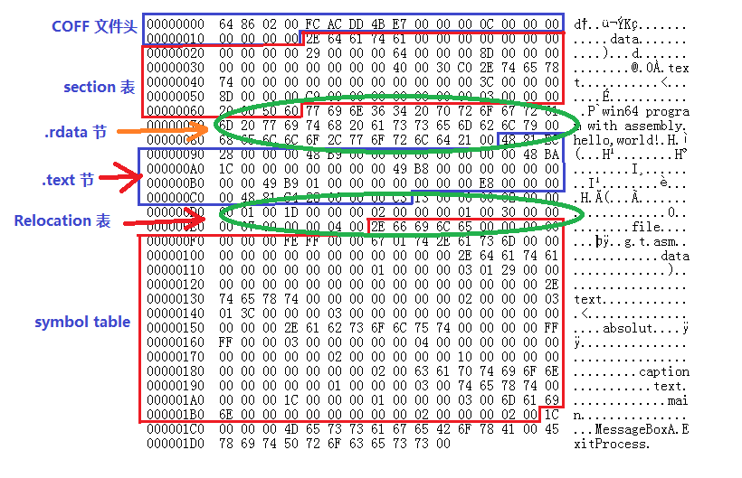
11.2.2 COFF (5/19)
Sample COFF Object File (little ending)
201001V1.1

Slide 70
11.2.2 COFF (6/19)
COFF file header structure
  The file header contains 20 bytes of information that describe the general format of an object file.
201001V1.1

Slide 71
11.2.2 COFF (7/19)
COFF file header (_IMAGE_FILE_HEADER) definition in WinNT.h
该文件运行所要求的CPU。对于Intel平台，该值是IMAGE_FILE_MACHINE_I386 (014Ch)
typedef struct _IMAGE_FILE_HEADER {
+00H WORD Machine;
+02H WORD NumberOfSections;
+04H DWORD TimeDateStamp;
+08H DWORD PointerToSymbolTable;
+0cH DWORD NumberOfSymbols;
+10H WORD SizeOfOptionalHeader;
+12H WORD Characteristics;
+14H
} IMAGE_FILE_HEADER, *PIMAGE_FILE_HEADER;
文件的节的数目，表示节表数组的大小
创建文件的日期和时间
201001V1.1

Slide 72
11.2.2 COFF (8/19)
COFF file header (_IMAGE_FILE_HEADER) definition in WinNT.h
符号表指针，该域只用在OBJ文件和带有COFF调试信息的PE文件中
typedef struct _IMAGE_FILE_HEADER {
+00H WORD Machine;
+02H WORD NumberOfSections;
+04H DWORD TimeDateStamp;
+08H DWORD PointerToSymbolTable;
+0cH DWORD NumberOfSymbols;
+10H WORD SizeOfOptionalHeader;
+12H WORD Characteristics;
+14H
} IMAGE_FILE_HEADER, *PIMAGE_FILE_HEADER;
符号表中的符号数目
指示紧随本结构之后的 OptionalHeader 结构大小，必须为有效值。
  很小的位集合，包括若干布尔标志位，指示诸如文件是否可执行，是否有符号信息，是否含有供调试器使用的行信息等
201001V1.1

Slide 73
11.2.2 COFF (9/19)
t.obj
00000000 64 86 // Machine (AMD 64 bit ) 00000002 02 00 // NumberOfSections 00000004 FC AC DD 4B // TimeDateStamp 00000008 E7 00 00 00 // PointerTosymbolTable 0000000C 0C 00 00 00 // NumberOfSymbols 00000010 00 00 // SizeOfOptionalHeader 00000012 00 00 // Characteristics
201001V1.1
Notes:
时间戳是自 1970 年 1 月 1 日（00:00:00 GMT）以来的秒数

Slide 74
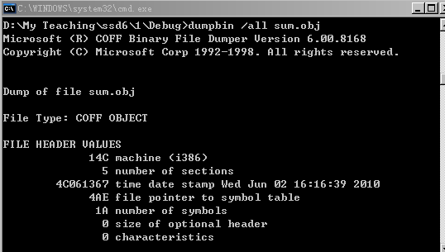
11.2.2 COFF (10/19)
dumpbin /all sum.obj>sum.txt
时间戳是自 1970 年 1 月 1 日（00:00:00 GMT）以来的秒数
201001V1.1

Slide 75
11.2.2 COFF (11/19)
值为0x010b时COFF文件是一个一般的可执行文件；值为0x0107时，COFF则为一个ROM镜像文件。
Optional File Header Format
typedef struct {
unsigned short usMagic; // 魔法数字
unsigned short usVersion; // 版本标识
unsigned long ulTextSize; // 正文（text）段大小
unsigned long ulInitDataSZ; // 已初始化数据段大小
unsigned long ulUninitDataSZ; // 未初始化数据段大小
unsigned long ulEntry; // 入口点
unsigned long ulTextBase; // 正文段基址
unsigned long ulDataBase; // 数据段基址（在PE32中才有）
} OPTHDR;
201001V1.1

Slide 76
11.2.2 COFF (12/19)
Section Table Definition in WinNT.h : SECTION_HEADER
#define IMAGE_SIZEOF_SHORT_NAME 8
typedef struct _IMAGE_SECTION_HEADER {
BYTE Name[IMAGE_SIZEOF_SHORT_NAME];
union {
DWORD PhysicalAddress;
DWORD VirtualSize;
} Misc;
DWORD VirtualAddress;
DWORD SizeOfRawData;
DWORD PointerToRawData;
DWORD PointerToRelocations;
DWORD PointerToLinenumbers;
WORD NumberOfRelocations;
WORD NumberOfLinenumbers;
DWORD Characteristics;
} IMAGE_SECTION_HEADER, *PIMAGE_SECTION_HEADER;
#define IMAGE_SIZEOF_SECTION_HEADER 40
.obj 中为0
0x0020 STYP_TEXT 正文段标识该段是代码。
0x0040 STYP_DATA 数据段标识，用来保存已初始化数据。
0x0080 STYP_BSS 有这个标识段也是用来保存未初始化数据。
201001V1.1
Notes:
Dword 4byte
Characteristics 只给出了部分bit的含义

Slide 77
11.2.2 COFF (13/19)
IMAGE_FILE_HEADER 结构中的 NumberOfSections = 2 得知，t.obj 有 2 个 section table，t.obj 的 section table 位置在 0x14 ~ 0x63 处，共 80 bytes，
201001V1.1

Slide 78
11.2.2 COFF (14/19)
Sample Section Table
00000014 2E 64 61 74 61 00 00 00 // name = ".data"
0000001C 00 00 00 00 // VirtualSize,not link yet
00000020 00 00 00 00 // VirtualAddress, not link yet
00000024 29 00 00 00 // SizeOfRawData
00000028 64 00 00 00 // PointerToRawData
0000002C 8D 00 00 00 // PointerToRelocation
00000030 00 00 00 00 // PointerToLinenumber
00000034 00 00 // NumberOfRelocation
00000036 00 00 // NumberOfLinenumbers
00000038 40 00 30 C0 // Characteristics
0000003C 2E 74 65 78 74 00 00 00 // name = ".text"
00000044 00 00 00 00 // VirtualSize
00000048 00 00 00 00 // VirtualAddress
0000004C 3C 00 00 00 // SizeOfRawData
00000050 8D 00 00 00 // PointerToRawData
00000054 C9 00 00 00 // PointerToRelocation
00000058 00 00 00 00 // PointerToLinenumber
0000005C 03 00 // NumberOfRelocation
0000005E 00 00 // NubmerOfLinenumbers
00000060 20 00 50 60 // Characteristics
201001V1.1
Notes:
2E 对应asc 的符号” .”
注意的是：这 2 个 section 的 VirtualSize 和 VirtualAddress 都是 0，由于 object 文件是未经过 link，因此，VirtualSize 和 VirtualAddress 都是 0 值。
.data 节的 PointerToRawData 是 64，SizeOfRawData 是 29，说明 .data 节在 t.obj 文件中的位置是 0x64 ~ 0x8C 共 41 bytes
.text 节的 PointerToRawData 是 8D, SizeOfRawData 是 3C，说明 .text 节在 t.obj 文件中的位置是 0x8D ~ 0xC8 共 60 bytes。而 .text 使用了 Relocation 表，这个 Relocation 位置在 0xC9 处，NumberOfRelocation = 03 表明，.text 使用 3 个 Relocation 表

Slide 79
11.2.2 COFF (15/19)
Relocation Information (Object Only)
  A COFF object file has one relocation entry for each relocatable reference.
  The assembler automatically generates relocation entries. The link step reads the relocation entries as it reads each input section and performs relocation.
  The relocation segment does not exist in executable files.
201001V1.1

Slide 80
11.2.2 COFF (16/19)
Relocation table(重定位表) definition (10 bytes)
typedef struct _IMAGE_RELOCATION {
union {
DWORD VirtualAddress; // virtual address of the reference
DWORD RelocCount;
// Set to the real count when IMAGE_SCN_LNK_NRELOC_OVFL is set
} DUMMYUNIONNAME;
DWORD SymbolTableIndex;
WORD Type;
} IMAGE_RELOCATION;
typedef IMAGE_RELOCATION UNALIGNED *PIMAGE_RELOCATION;
域 | size | 描述
VritualAddress | DWORD | 指出 section 中的哪个 RVA 地址需要进行 relocate 操作
SymbolTableIndex | DWORD | 用来在 Symbol table 中进行索引
Type | WORD | 表明 VirtualAddress 是个怎样类型的 address
201001V1.1

Slide 81
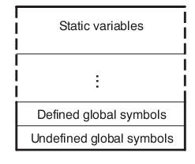
11.2.2 COFF (17/19)
Symbol Table CSAPP 7.5
  Each relocatable object module, m, has a symbol table that contains information about the symbols that are defined and referenced by m.
Content:
  由m定义的全局变量
  m引用的全局变量
  m定义和引用的本地符号，
  如静态的局部变量，
  目标文件中对应于m的节（section）
  和相应源文件的名字
201001V1.1
Notes:
P467

Slide 82
11.2.2 COFF (18/19)
Symbol Table (_IMAGE_SYMBOL ) definition in WinNT.h
typedef struct _IMAGE_SYMBOL {
union {
BYTE ShortName[8];
struct {
DWORD Short; // if 0, use LongName
DWORD Long; // offset into string table
} Name;
DWORD LongName[2]; // PBYTE [2]
} N;
DWORD Value;
SHORT SectionNumber;
WORD Type;
BYTE StorageClass;
BYTE NumberOfAuxSymbols;
} IMAGE_SYMBOL;
typedef IMAGE_SYMBOL UNALIGNED *PIMAGE_SYMBOL;
#define IMAGE_SIZEOF_SYMBOL 18
201001V1.1

Slide 83
11.2.2 COFF (19/19)
String Table: Contains long symbol names.
  The string table contains the null terminated names of symbols longer than eight characters.
  Those symbols point into the string table through an offset
201001V1.1

Slide 84
11.2 Object File
11.2.1 Object File Introduction
11.2.2 COFF
11.2.3 PE
201001V1.1

Slide 85
11.2.3 PE
11.2.3.1 General PE properties
11.2.3.2 MS-DOS header
11.2.3.3 The NT header
11.2.3.4 Section Table
11.2.3.5 Common Sections
201001V1.1

Slide 86
11.2.3.1 General PE properties (1/3)
The PE (Portable Executable 可移植可执行) is the extension of COFF
Section have names, some commonly used names like
    .text or CODE for x86 binary code
    .idata for lists of imported .DLLs with their imported functions
    .edata for the .DLL exported functions
201001V1.1

Slide 87
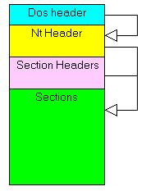
11.2.3.1 General PE properties (2/3)
PE overall structure contains:
  a MS-DOS header
  a NT header
  a Section header list (Section table )
  the list of Sections
201001V1.1

Slide 88
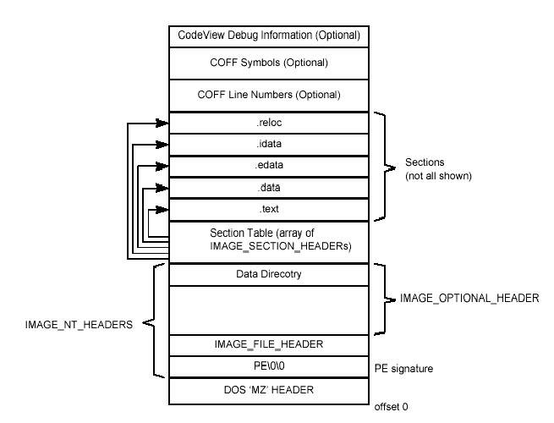
11.2.3.1 General PE properties (3/3)
201001V1.1

Slide 89
11.2.3 PE
11.2.3.1 General PE properties
11.2.3.2 MS-DOS header
11.2.3.3 The NT header
11.2.3.4 Section Table
11.2.3.5 Common Sections
201001V1.1

Slide 90
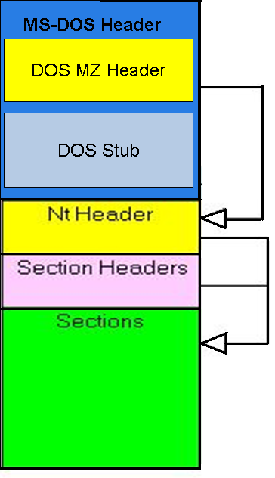
11.2.3.2 MS-DOS header (1/4)
MS-DOS header is composed of
  DOS MZ Header, 64 Bytes
    a signature (0x4D5A, which is MZ, Mark Zbikowski, a Dos architect)
    the address of the main table which is the NT header
  DOS Stub, 112 Byte
    DOS Stub(桩代码) will execute and print out the message “This program cannot be run in DOS mode” if run PE file under MS-DOS instead of Windows
201001V1.1
Notes:
The historical part allowed to compatible with MS-DOS. If run PE file under MS-DOS, the DOS Stub(桩代码) will execute and print out the message “This program cannot be run in DOS mode”, Otherwise, Windows was loaded from DOS.

Slide 91
11.2.3.2 MS-DOS header (2/4)
DOS MZ header (_IMAGE_DOS_HEADER ) definition in WinNT.h
201001V1.1

Slide 92
11.2.3.2 MS-DOS header (3/4)
typedef struct _IMAGE_DOS_HEADER { // DOS .EXE header
+00h WORD e_magic; // Magic number，DOS可执行文件标记“MZ”
+02h WORD e_cblp; // Bytes on last page of file
+04h WORD e_cp; // Pages in file
+06h WORD e_crlc; // Relocations
+08h WORD e_cparhdr; // Size of header in paragraphs
+0ah WORD e_minalloc; // Minimum extra paragraphs needed
+0ch WORD e_maxalloc; // Maximum extra paragraphs needed
+0eh WORD e_ss; // Initial (relative) SS value
+10h WORD e_sp; // Initial SP value
+12h WORD e_csum; // Checksum
+14h WORD e_ip; // Initial IP value,DOS代码入口IP
+16h WORD e_cs; // Initial (relative) CS value，DOS代码入口CS
+18h WORD e_lfarlc; // File address of relocation table
+1ah WORD e_ovno; // Overlay number
+1ch WORD e_res[4]; // Reserved words
+24h WORD e_oemid; // OEM identifier (for e_oeminfo)
+26h WORD e_oeminfo; // OEM information; e_oemid specific
+3ah WORD e_res2[10]; // Reserved words
+3ch LONG e_lfanew; // File address of new exe header; 指向PE文件头"PE",0,0
+40h
} IMAGE_DOS_HEADER, *PIMAGE_DOS_HEADER;
201001V1.1

Slide 93
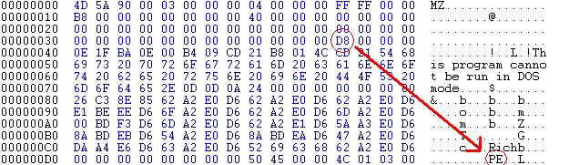
11.2.3.2 MS-DOS header (4/4)
201001V1.1

Slide 94
11.2.3 PE
11.2.3.1 General PE properties
11.2.3.2 MS-DOS header
11.2.3.3 The NT header
11.2.3.4 Section Table
11.2.3.5 Common Sections
201001V1.1

Slide 95
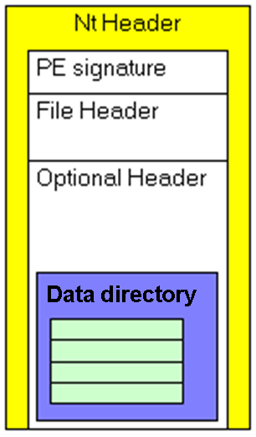
11.2.3.3 The NT header (1/9)
The NT header is composed of
  PE signature, 4 bytes, which is “PE” followed by 2 NULL bytes
  a COFF file header, 20 bytes
  “optional” header (which is not optional at all)，224 bytes
    Data directory (128 bytes, 数据目录表)
201001V1.1

Slide 96
11.2.3.3 The NT header (2/9)
NT header (_IMAGE_NT_HEADERS ) definition in WinNT.h
typedef struct _IMAGE_NT_HEADERS {
+00H DWORD Signature;
+04H IMAGE_FILE_HEADER FileHeader;
+18H IMAGE_OPTIONAL_HEADER32 OptionalHeader;
+f8H
} IMAGE_NT_HEADERS32, *PIMAGE_NT_HEADERS32
201001V1.1

Slide 97
11.2.3.3 The NT header (3/9)
COFF file header (_IMAGE_FILE_HEADER ) definition in WinNT.h
typedef struct _IMAGE_FILE_HEADER {
+00H WORD Machine;
+02H WORD NumberOfSections;
+04H DWORD TimeDateStamp;
+08H DWORD PointerToSymbolTable;
+0cH DWORD NumberOfSymbols;
+10H WORD SizeOfOptionalHeader;
+12H WORD Characteristics;
+14H
} IMAGE_FILE_HEADER, *PIMAGE_FILE_HEADER;
201001V1.1

Slide 98
11.2.3.3 The NT header (4/9)
Optional Header
  ImageBase
    The virtual address where the first byte of the file will be loaded is called image base address.
  Data directory (Image Only)
    An array of 16 structures telling where the Sections are located.
201001V1.1
Notes:
可选头部包含了很多关于可执行映像的重要信息，例如初始的堆栈大小、程序入口点的位置、首选基地址、操作系统版本、段对齐的信息等等。

Slide 99
11.2.3.3 The NT header (5/9)
Optional header (_IMAGE_OPTIONAL_HEADER) definition in WinNT.h(1)
typedef struct _IMAGE_OPTIONAL_HEADER {
// Standard fields.
+00H WORD Magic; //魔数，(总是010bh)
+02H BYTE MajorLinkerVersion; //链接器版本号
+03H BYTE MinorLinkerVersion;
+04H DWORD SizeOfCode; //代码段大小
+08H DWORD SizeOfInitializedData; //已初始化数据块大小
+0cH DWORD SizeOfUninitializedData; //未初始化数据块大小
+10H DWORD AddressOfEntryPoint; //程序入口RVA, main()的地址
+14H DWORD BaseOfCode; //文件代码节开始处的RVA
+18H DWORD BaseOfData; //数据节开始处的RVA
201001V1.1
Notes:
这个结构中所列出的域实在是冗长得过分。首先，请注意这个结构被划分为“标准域”和“NT附加域”。所谓标准域，就是和UNIX可执行文件的COFF格式所公共的部分。
在标准域中，AddressOfEntryPoint域是对PE文件格式来说最为有趣的了。这个域表示应用程序入口点的位置。并且，对于系统黑客来说，这个位置就是导入地址表（IAT）的末尾。 加载器运行PE文件的第一条指令的RVA就在这里.如果你想让程序在正常运行程序之前再干点什么,就可以通过改动这个RVA来解决,让RVA的位置指 向你想让他执行的开始位置就可以了.
ImageBase是程序载入内存的初始地址，也就就整个PE文件的最前面入口地址，通过这个地址可以定位到PE的任何结构数据。
BaseOfCode是代码段数据的首地址。
AddressOfEntryPoint是程序执行的入口函数地址，可以存在于BaseOfCode段或其他代码段中的任意位置。

Slide 100
11.2.3.3 The NT header (6/9)
Optional header (_IMAGE_OPTIONAL_HEADER) definition in WinNT.h(2) support loader
// NT additional fields.
+1cH DWORD ImageBase; // 进程映像地址空间中首选基地址+20H DWORD SectionAlignment; //内存中的块对齐粒度 (如1000h)
+24H DWORD FileAlignment; //文件中的块对齐粒度
+28H WORD MajorOperatingSystemVersion; //操作系统主版本号
+2aH WORD MinorOperatingSystemVersion; //操作系统副版本号
+2cH WORD MajorImageVersion; //用户自定义版本号
+2eH WORD MinorImageVersion;
+30H WORD MajorSubsystemVersion; //需子系统版本号
+32H WORD MinorSubsystemVersion;
+34H DWORD Win32VersionValue;
+38H DWORD SizeOfImage; //内存中整个PE映像尺寸
+3cH DWORD SizeOfHeaders; //所有头+节表的大小
+40H DWORD CheckSum; //校验和
+44H WORD Subsystem; //文件的子系统（GUI or CUI…）
201001V1.1
Notes:
添加到Windows NT PE文件格式中的附加域为Windows NT特定的进程行为提供了装载器的支持
·ImageBase。进程映像地址空间中的首选基地址。Windows NT的Microsoft Win32 SDK链接器将这个值默认设为0x00400000，可以使用-BASE:linker开关改变这个值。PE文件被加载的首选地址.举个例子:如果这个值是400000h.那么PE加载器将尝试把虚拟地址空间[virtual address space]400000h的起始位置加载文件,这个所谓的尝试几乎99%都成功的把它加载到指定位置,当然除非其他模块[module]已经占领了这个地址范围[address range].
FileAlignment是节[section]在文件中的校准粒度。举个例子:如果这个值是512(200h),那么每个节的开始地址的大小必须是512bytes的倍数,如果第一个节[section]的
文件偏移[file offset]是512(200h)大小是10bytes,那么紧跟着的下一个节必须开始于文件偏移400h的地方.[也就是说从文件偏移 522(20ah)到1024(400h)的地方没有被使用/定义]
SectionAlignment节[section]在内存中的校准粒度[the granularity of the alignment].举个例子:如果这个值是4096(1000h),每个节的起始位置的大小必须是4096bytes的倍数,如果第一个节 [section]的在内存的401000h的地方大小是10bytes,那么紧跟着的下一个节必须开始于402000的地方.[也就是说从401000h到402000h将 不会被使用]

Slide 101
11.2.3.3 The NT header (7/9)
Optional header (_IMAGE_OPTIONAL_HEADER) definition in WinNT.h(3)
+46H WORD DllCharacteristics; //DllMain()何时被调用,默认为0
+48H DWORD SizeOfStackReserve; //初始化时的堆栈预留大小
+4cH DWORD SizeOfStackCommit; //初始化时实际提交的堆栈大小
+50H DWORD SizeOfHeapReserve; //初始化时预留的堆大小
+54H DWORD SizeOfHeapCommit; //初始化时实际提交的堆大小
+58H DWORD LoaderFlags; //与调试有关,默认为0
+5cH DWORD NumberOfRvaAndSizes; //数据目录结构的数量
+60H IMAGE_DATA_DIRECTORY DataDirectory[IMAGE_NUMBEROF_DIRECTORY_ENTRIES];
+e0H
} IMAGE_OPTIONAL_HEADER32, *PIMAGE_PTIONAL_HEADER32;
201001V1.1

Slide 102
11.2.3.3 The NT header (8/9)
Data direcory (_IMAGE_DATA_DIRECTORY) definition in WinNT.h
typedef struct _IMAGE_DATA_DIRECTORY {
+00H DWORD VirtualAddress;
+04H DWORD Size;
+08H
}IMAGE_DATA_DIRECTORY, *PIMAGE_DATA_DIRECTORY;
#define IMAGE_NUMBEROF_DIRECTORY_ENTRIES 16
201001V1.1

Slide 103
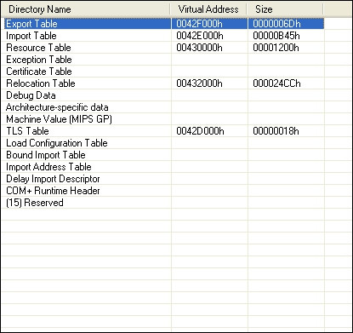
11.2.3.3 The NT header (9/9)
201001V1.1

Slide 104
11.2.3 PE
11.2.3.1 General PE properties
11.2.3.2 MS-DOS header
11.2.3.3 The NT header
11.2.3.4 Section Table
11.2.3.5 Common Sections
201001V1.1
Notes:
PEBrowsePro 工具

Slide 105
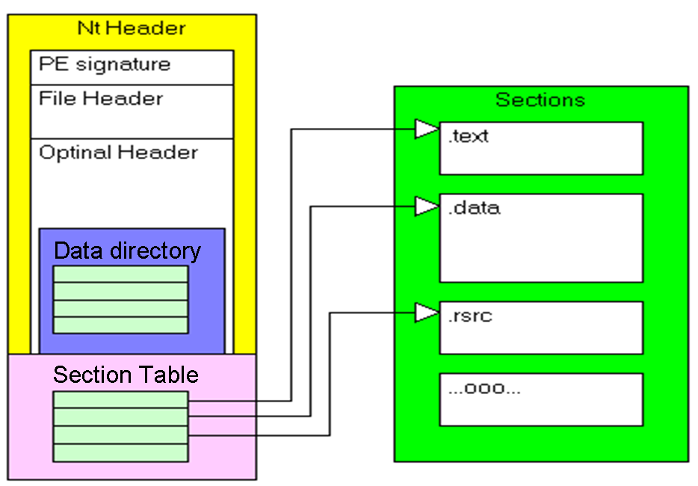
11.2.3.4 Section Table (1/4)
The section table is essentially a phone book containing information about each section in the image.
  An array of IMAGE_SECTION_HEADERs structures.
201001V1.1
Notes:
The sections in the image are sorted by their starting address (RVAs).

Slide 106
11.2.3.4 Section Table (2/4)
_IMAGE_SECTION_HEADER definition in WinNT.h
typedef struct _IMAGE_SECTION_HEADER {
+00H BYTE Name[IMAGE_SIZEOF_SHORT_NAME]; //节表名称,如“.text” +08H union {
DWORD PhysicalAddress; //物理地址
DWORD VirtualSize; //真实长度
} Misc;
+0bH DWORD VirtualAddress; //虚拟地址
+10H DWORD SizeOfRawData; //物理长度 +14H DWORD PointerToRawData;
//节在文件中的位置
+18H DWORD PointerToRelocations; //该段在重定位表中的位置
+1bH DWORD PointerToLinenumbers; //该段的行号表在文件中的位置
+20H WORD NumberOfRelocations; //重定位项数目
+22H WORD NumberOfLinenumbers; //行号表的数目
+24H DWORD Characteristics; //节属性,可读？可写？
+28H
} IMAGE_SECTION_HEADER, *PIMAGE_SECTION_HEADER;
#define IMAGE_SIZEOF_SHORT_NAME 8
201001V1.1
Notes:
“PhysicalAddress（物理地址）”和“VirtualSize（虚拟大小）”组成的共用体。在目标文件中，它是内容重定位到的地址；在可执行文件中，它是内容的大小。
原始数据指针”，32位），它特别有用，因为它是从文件的开头到节中数据的偏移量。如果它 为0，那么节的数据就不包含在文件中，并且要在载入时才定。

Slide 107
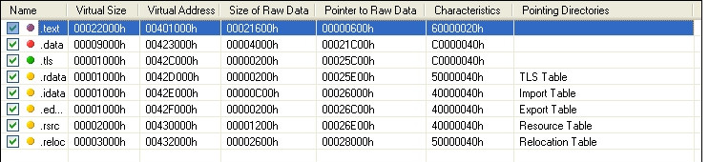
11.2.3.4 Section Table (3/4)
201001V1.1
Notes:
SectionAlignment主要指的是PE文件被映射到内存后，其section被映射到进程空间时所采用的数据对齐的大小。一般就是一个页大小的倍数（通常为1000h）。这个也是为了更快的进行数据交换，便于内存管理。

Slide 108
11.2.3.4 Section Table (4/4)
01 .text VirtSize: 00005AFA VirtAddr: 00001000
raw data offs: 00000400 raw data size: 00005C00
relocation offs: 00000000 relocations: 00000000
line # offs: 00009220 line #'s: 0000020C
characteristics: 60000020
CODE MEM_EXECUTE MEM_READ
02 .bss VirtSize: 00001438 VirtAddr: 00007000
raw data offs: 00000000 raw data size: 00001600
relocation offs: 00000000 relocations: 00000000
line # offs: 00000000 line #'s: 00000000
characteristics: C0000080
UNINITIALIZED_DATA MEM_READ MEM_WRITE
03 .rdata VirtSize: 0000015C VirtAddr: 00009000
raw data offs: 00006000 raw data size: 00000200
relocation offs: 00000000 relocations: 00000000
line # offs: 00000000 line #'s: 00000000
characteristics: 40000040
INITIALIZED_DATA MEM_READ
04 .data VirtSize: 0000239C VirtAddr: 0000A000
raw data offs: 00006200 raw data size: 00002400
relocation offs: 00000000 relocations: 00000000
line # offs: 00000000 line #'s: 00000000
characteristics: C0000040
INITIALIZED_DATA MEM_READ MEM_WRITE
05 .idata VirtSize: 0000033E VirtAddr: 0000D000
raw data offs: 00008600 raw data size: 00000400
relocation offs: 00000000 relocations: 00000000
line # offs: 00000000 line #'s: 00000000
characteristics: C0000040
INITIALIZED_DATA MEM_READ MEM_WRITE
06 .reloc VirtSize: 000006CE VirtAddr: 0000E000
raw data offs: 00008A00 raw data size: 00000800
relocation offs: 00000000 relocations: 00000000
line # offs: 00000000 line #'s: 00000000
characteristics: 42000040
INITIALIZED_DATA MEM_DISCARDABLE MEM_READ
A Typical Section Table from an EXE File
201001V1.1

Slide 109
11.2.3 PE
11.2.3.1 General PE properties
11.2.3.2 MS-DOS header
11.2.3.3 The NT header
11.2.3.4 Section Table
11.2.3.5 Common Sections
201001V1.1

Slide 110
11.2.3.5 Common Sections (1/5)
201001V1.1

Slide 111
11.2.3.5 Common Sections (2/5)
.text section
  .text is the default section for code.
  The linker concatenates all the .text sections from the various OBJs into one big .text section in the EXE.
.data section
  where your initialized data goes.
  This data consists of global and static variables that are initialized at compile time. It also includes string literals.
  The linker combines all the .data sections from the OBJ and LIB files into one .data section in the EXE.
  Local variables are located on a thread's stack, and take no room in the .data or .bss sections.
201001V1.1

Slide 112
11.2.3.5 Common Sections (3/5)
.bss section
  where any uninitialized static and global variables are stored.
  The linker combines all the .bss sections in the OBJ and LIB files into one .bss section in the EXE.
  In the section table, the RawDataOffset field for the .bss section is set to 0, indicating that this section doesn't take up any space in the file.
.CRT
  Another initialized data section utilized by the Microsoft C/C++ run-time libraries
201001V1.1

Slide 113
11.2.3.5 Common Sections (4/5)
.idata section
  Contains information about functions (and data) that the module imports from other DLLs.
  Each function that a PE file imports is specifically listed in this section.
.edata section
  A list of the functions and data that the PE file exports for other modules.
  There's seldom a reason to export anything from an EXE file, so you usually only see .edata sections in DLLs.
201001V1.1

Slide 114
11.2.3.5 Common Sections (5/5)
Section Name | 作用
.arch | 最初的构建信息(Alpha Architecture Information)
.bss | 未初始化的全局变量和静态变量
.CRT | 微软的c/c++ runtime library(CRT),main or winmain 之前执行
.data | 初始化的全局变量和静态变量
.debug | 调试信息
.didata | 延迟输入文件名表
.edata | 输出函数的相关信息, export
.idata | 内含从DLLS中输入的函数的相关信息, import
.pdata | 异常信息(Exception Information)
.rdata | 只读的初始化数据，用于放置TLS(thread local storage)的directory ，
.reloc | 重定位表信息
.rsrc | 资源节
.text | 已编译程序的机器代码,联结器把所有的.OBJ的.text集合到一个大个的.text中
.tls | 线程的本地存储器
.xdata | 异常处理表
201001V1.1

